Slide 1

Vectors and Grids
Chris Piech
CS 106B
Lecture 2
Jan 9, 2015

Slide 2

Announcements
Honor code!
Help Calendar
The Life YEAH session will be Monday 5-6pm in BishopAud
Megan Special OH on Monday 10-11am in Gates 104
Chris Special OH today 2:30-3:30pm in Gates 193
LaIR opens on Sunday
Section sign ups are open
Corresponding Handout Today

Slide 3
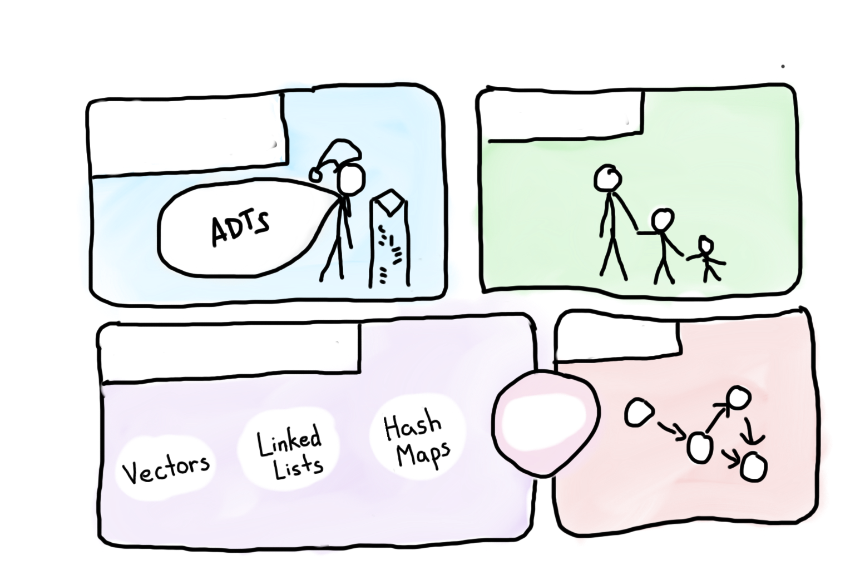

Course Syllabus
Intro to Abstractions
Recursion
Graphs
Under the Hood
Trees
You are here

Slide 4

Today’s Goals
Learn about Vectors
Learn about Grids

Slide 5

Today’s Goals
Friday
Raptors
Grids
Vectors
Game Show

Slide 6
Today’s Goals
Friday
Raptors
Grids
Vectors
Game Show

Slide 7
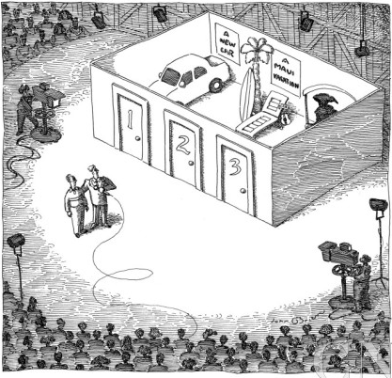
CS106B Game Show

Slide 8
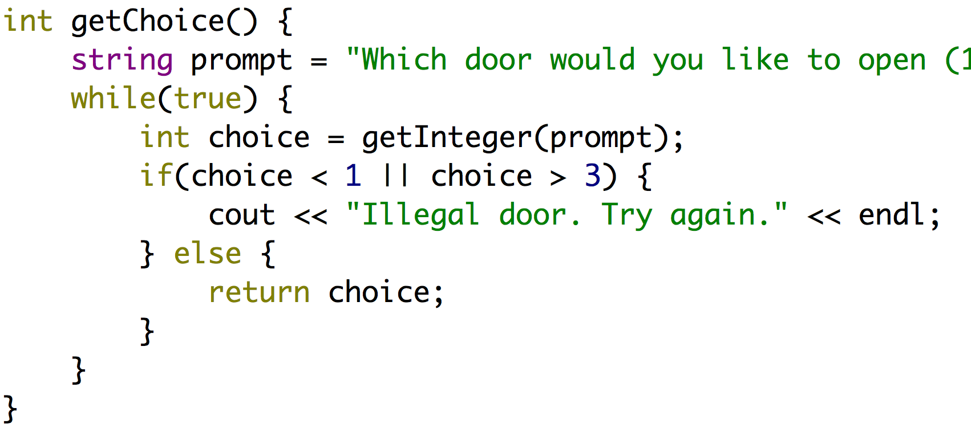
Helper Function

Slide 9
Helper Function
Function that returns an integer

Slide 10
Helper Function

Slide 11
Helper Function
Useful Stanford Library function

Slide 12
Helper Function

Slide 13
Welcome Message in a File
welcome.txt
6
Welcome to the CS106B game show!
You stand infront of three doors
and behind each door is a special prize.
Will you be brave?
Will you be wise?
Step right up and try your luck.

Slide 14
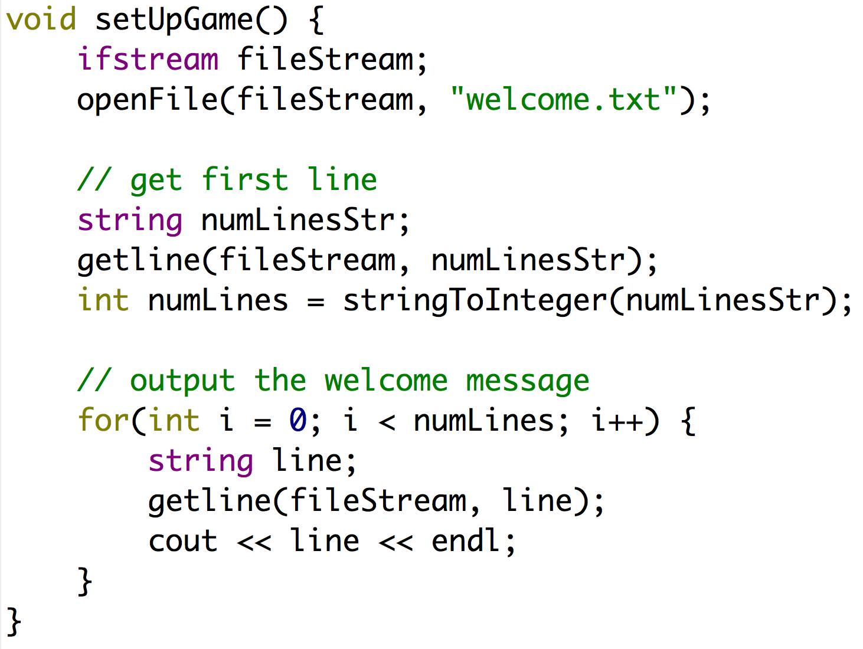
Another Helper Function

Slide 15
Another Helper Function
Creates a file
stream variable

Slide 16
Another Helper Function
Opens the file
“welcome.txt”

Slide 17
Another Helper Function
Declares a string

Slide 18
Another Helper Function
Puts the next line in the file into the string

Slide 19
Another Helper Function
Interprets the first line as an int

Slide 20
Another Helper Function
Loop numLines times

Slide 21
Another Helper Function
Each time read another line from the file and cout it

Slide 22
Another Helper Function

Slide 23
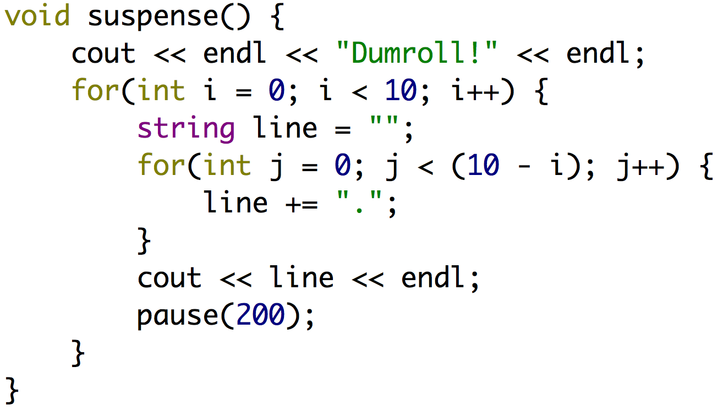
Another Helper Function

Slide 24
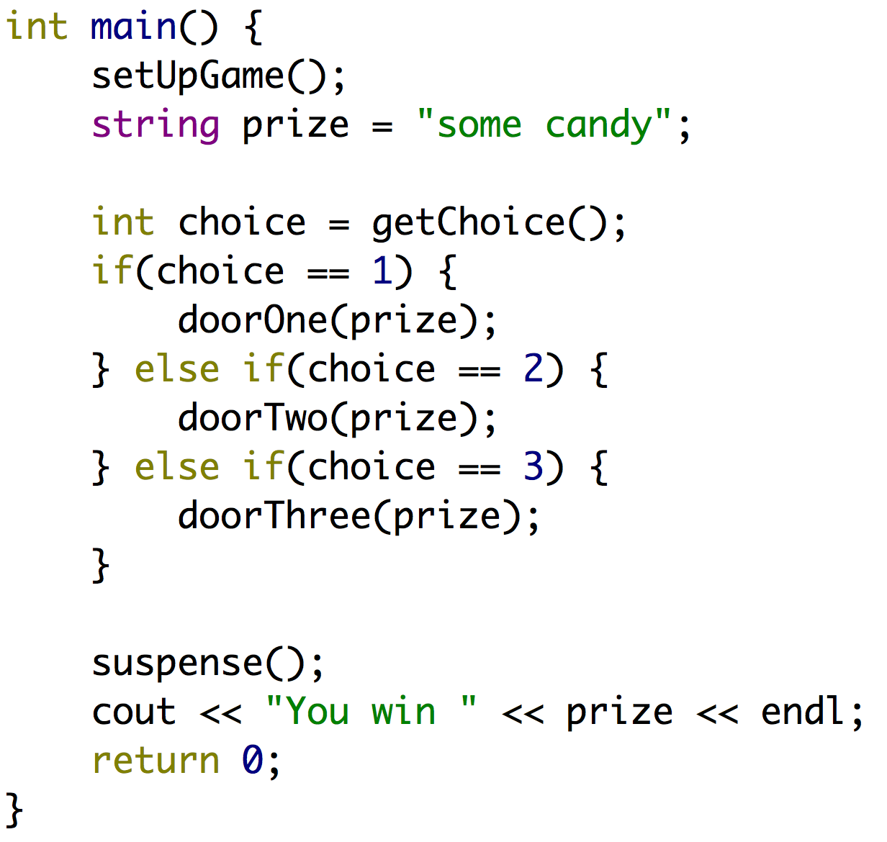
CS106B Game Show

Slide 25
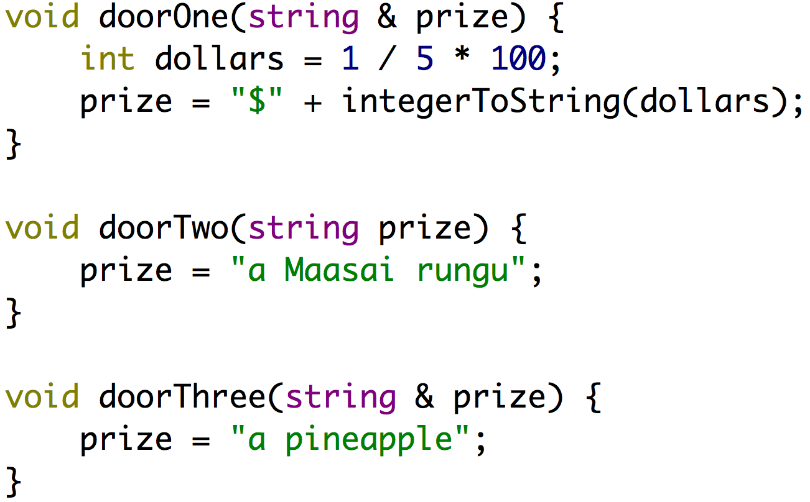
The Doors

Slide 26

Volunteer

Slide 27
The Doors

Slide 28
The Doors
Integer divided by an integer results in an integer… which is floored
Not passed by reference. Changes don’t persist.
Pineapples are delicious and healthy.

Slide 29
Today’s Goals
Friday
Raptors
Grids
Vectors
Game Show

Slide 30
Today’s Goals
Friday
Raptors
Grids
Vectors
Game Show

Slide 31
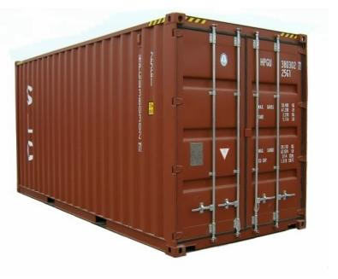
Collections Lecture 1

Slide 32
Collections
Vector
Grid
Map
Stack
Queue
Set

Slide 33
Collections
Vector
Grid
Map
Stack
Queue
Set

Slide 34
Collections
Vector

Slide 35
Vector<type>
What is it?
ArrayList<type>
A list of elements that can grow and shrink. Each element has a place (or index) in the list.
Advanced array.
Important Details
Constructor creates an empty list.
Indexed by 0.
Bounds checks.
Knows its size.
Why not use arrays?

Slide 36
Vector Creation
Vector<int> vec;
or
Vector<int> vec();

Slide 37
Vector Methods
vec.size()
Returns the number of elements in the vector.
vec.isEmpty()
Returns true if the vector is empty.
vec[i]
Selects the i^{th} element of the vector.
vec.add(value)
Adds a new element to the end of the vector.
vec.insert(index, value)
Inserts the value before the specified index position.
vec.remove(index)
Removes the element at the specified index.
vec.clear()
Removes all elements from the vector.
For the exhaustive list check out http://stanford.edu/~stepp/cppdoc/Vector-class.html

Slide 38
Vector Example
Vector<int> magic;
magic.add(4);
magic.add(8);
magic.add(15);
magic.add(16);
cout << magic[2] << endl;

Slide 39
Vector Example
Vector<int> magic;
magic.add(4);
magic.add(8);
magic.add(15);
magic.add(16);
cout << magic[2] << endl;
magic:

Slide 40
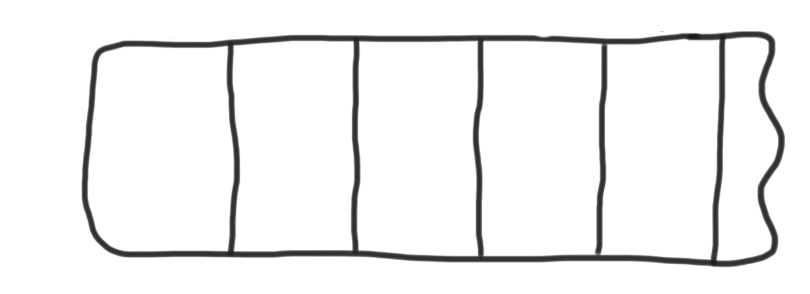
Vector Example
Vector<int> magic;
magic.add(4);
magic.add(8);
magic.add(15);
magic.add(16);
cout << magic[2] << endl;
magic:
0
4

Slide 41
Vector Example
Vector<int> magic;
magic.add(4);
magic.add(8);
magic.add(15);
magic.add(16);
cout << magic[2] << endl;
magic:
0
1
4
8

Slide 42
Vector Example
Vector<int> magic;
magic.add(4);
magic.add(8);
magic.add(15);
magic.add(16);
cout << magic[2] << endl;
magic:
0
1
2
4
8
15

Slide 43
Vector Example
Vector<int> magic;
magic.add(4);
magic.add(8);
magic.add(15);
magic.add(16);
cout << magic[2] << endl;
magic:
0
1
2
3
4
8
15
16

Slide 44

Vector Example
Vector<int> magic;
magic.add(4);
magic.add(8);
magic.add(15);
magic.add(16);
cout << magic[2] << endl;
magic:
0
1
2
3
4
8
15
16

Slide 45
Vector Example
for(int i = 0; i < magic.length(); i++) {
cout << magic[i]
}
magic:
0
1
2
3
4
8
15
16

Slide 46
Vector Example
4
for(int i = 0; i < magic.length(); i++) {
cout << magic[i]
}
magic:
0
1
2
3
4
8
15
16

Slide 47
Vector Example
for(int i = 0; i < magic.length(); i++) {
cout << magic[i]
}
magic:
0
1
2
3
8
15
i:
0
4
16

Slide 48
Vector Example
for(int i = 0; i < magic.length(); i++) {
cout << magic[i]
}
magic:
0
1
2
3
8
15
i:
0
4
16

Slide 49
Vector Example
for(int i = 0; i < magic.length(); i++) {
cout << magic[i]
}
magic:
0
1
2
3
8
15
i:
1
4
16

Slide 50
Vector Example
for(int i = 0; i < magic.length(); i++) {
cout << magic[i]
}
magic:
0
1
2
3
8
15
i:
2
4
16

Slide 51
Vector Example
for(int i = 0; i < magic.length(); i++) {
cout << magic[i]
}
magic:
0
1
2
3
8
15
i:
3
4
16

Slide 52
Today’s Goals
Friday
Raptors
Grids
Vectors
Game Show

Slide 53
Today’s Goals
Friday
Raptors
Grids
Vectors
Game Show

Slide 54
Collections
Vector
Grid
Map
Stack
Queue
Set

Slide 55
Collections
Grid

Slide 56

Grid<type>

Slide 57
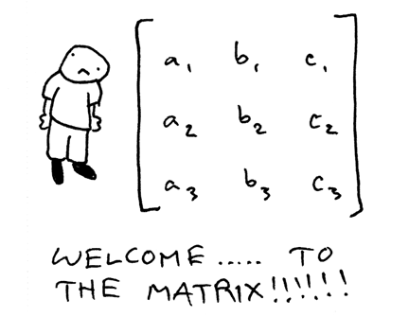
Grid<type>

Slide 58
Grid Overview
What is it?
Advanced 2D array.
Think spread sheets, game boards
Important Details
Default constructor makes a grid of size 0
Doesn’t support “ragged right”.
Bounds checks
Knows its size.

Slide 59
Grid Creation
Grid<string> grid;
or
Grid<string> grid(3, 4);

Slide 60
Grid Methods
grid.numRows()
Returns the number of rows in the grid.
grid.numCols()
Returns the number of columns in the grid.
grid[i][j]
Selects the element in the i^{th} row and j^{th} column.
grid.resize(rows, cols)
Changes the dimensions of the grid and clears any previous contents.
grid.inBounds(row, col)
Returns true if the specified row , column position is within the grid.

Slide 61
Collections
Defined as Classes
This means they have constructors and member functions
Templatized
They have a mechanism for collecting different variable types
Deep copy assignment
Often pass them by reference!

Slide 62

Common Pitfalls 1
Vector numbers;

Slide 63

Common Pitfalls 1
Vector<int> numbers;

Slide 64
Common Pitfalls 2
Vector<Vector<int>> numbers;

Slide 65
Common Pitfalls 2
Vector<Vector<int> > numbers;

Slide 66
Common Pitfalls 3
void myFunction(Grid<bool> gridParam);

Slide 67
Common Pitfalls 3
void myFunction(Grid<bool> & gridParam);

Slide 68
Today’s Goals
Friday
Raptors
Grids
Vectors
Game Show

Slide 69
Today’s Goals
Friday
Raptors
Grids
Vectors
Game Show

Slide 70
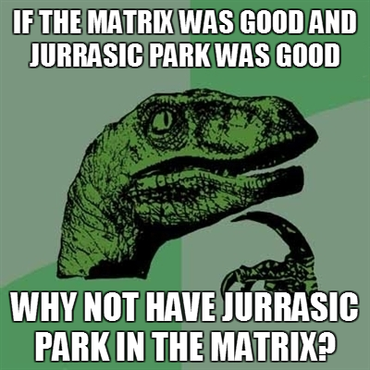

Slide 71
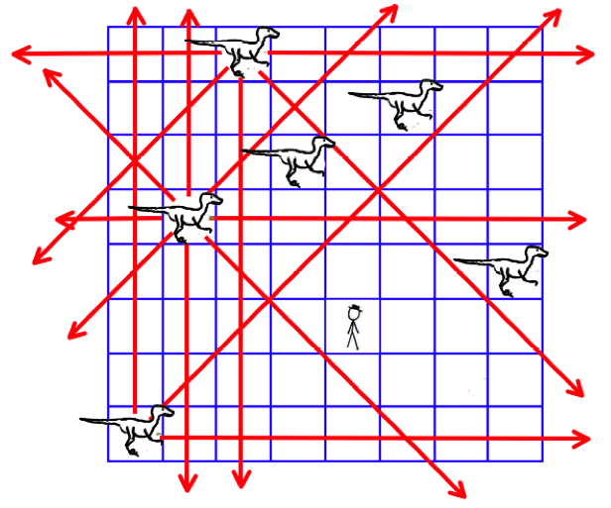
Velociraptor Safety

Slide 72
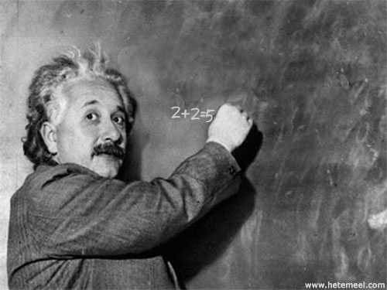
CS106B helps with life skills
Life Skills on the Board

Slide 73
Today’s Goals
Friday
Raptors
Grids
Vectors
Game Show

Slide 74
Today’s Goals
Learn about Vectors
Learn about Grids
Ready for Life

Slide 75
